Slide 1
Machine Learning
Gradient Descent Algorithm
Linear Regression
Non-Linear Regression
Logistic Regression
Decision Trees
Regression Trees
Classification Trees
Clustering Algorithms
K-Means
Hierarchical clustering
DB-Scan
Mean Shift
GMM
Support Vector Machine
Deep Learning
MLP
CNN
Datasets
Breast Cancer Wisconsin
MIMIC-III
Framingham Heart Study
Alzheimer’s Disease Neuroimaging Initiative
Drug discovery
Microbiome

Slide 2
Tree Based Models
my humble ML course

Slide 3
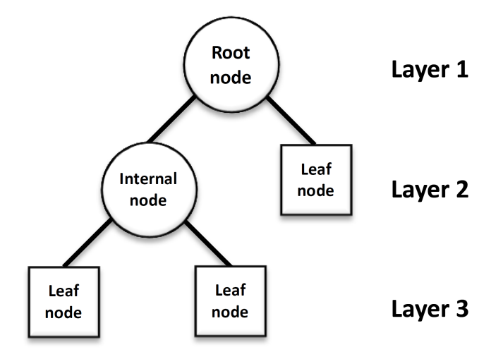
C4 – DT growing algorithm
my humble ML course

Slide 4
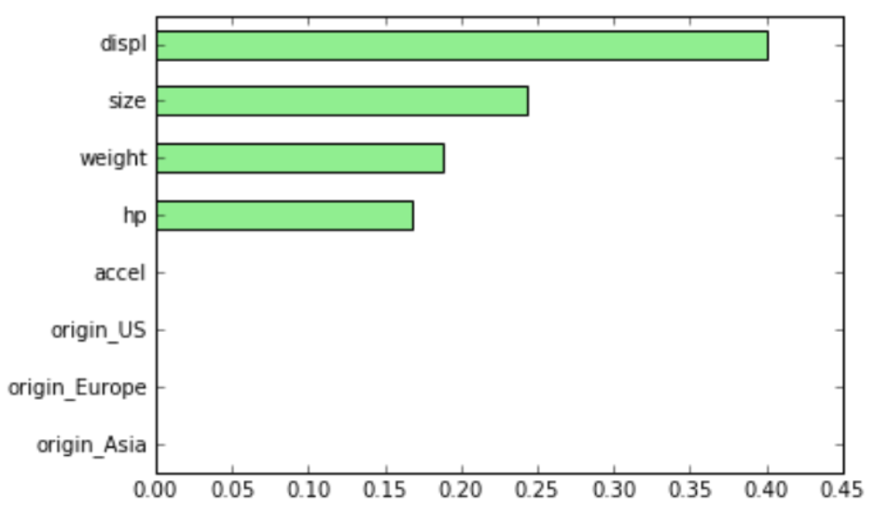
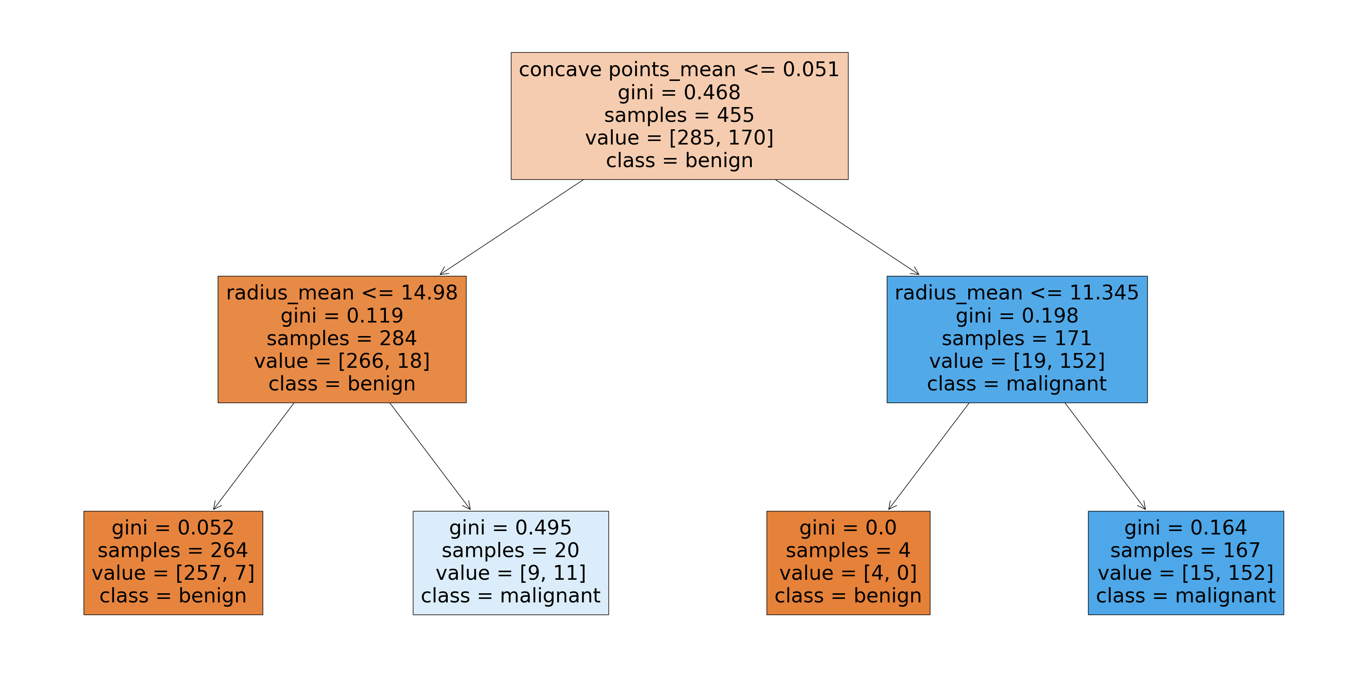
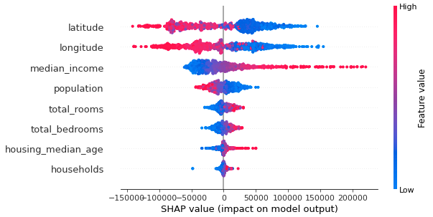
my humble ML course
Feature
importance

Slide 5
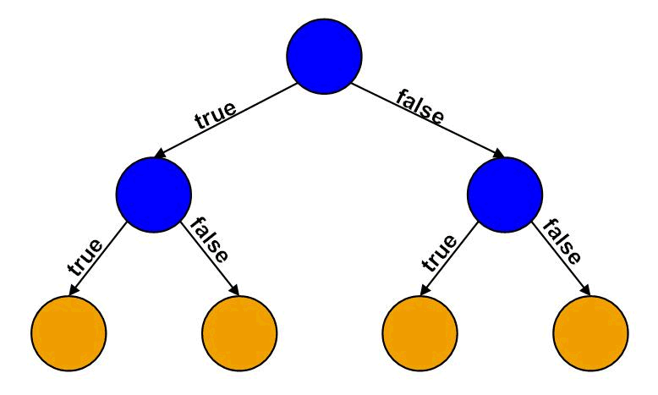
my humble ML course
Decision Tree
GOAL: Learn if else-questions with each question involving one feature and one split-point
HOW:
Divides the feature-space (N-dimensional) into regions where all instances in one region are assigned to only one class-label (discrete or continue).

Slide 6
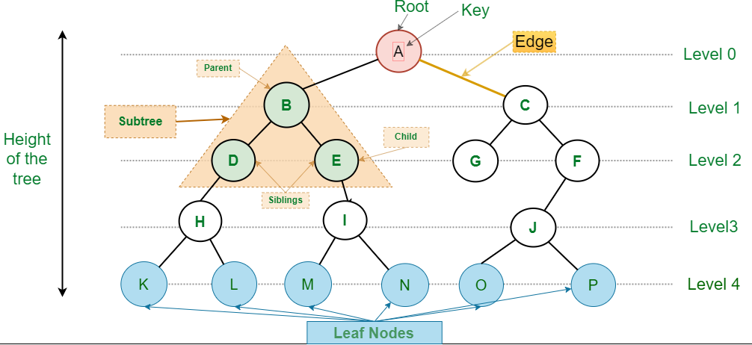
my humble ML course
Decision Tree building blocks
DT: data structure consisting of a hierarchy of nodes (individual units).
NODE:
ROOT: no-parent node
INTERNAL NODE: question giving rise to two children nodes
LEAF: prediction(discrete or continue), no children nodes.

Slide 7
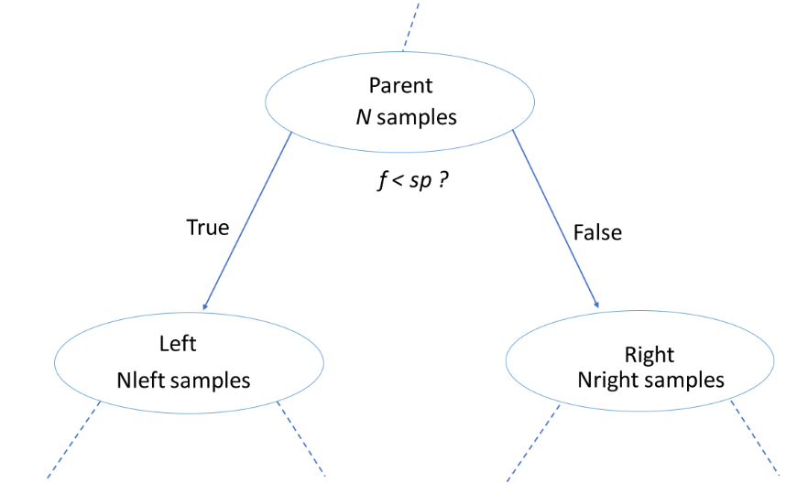
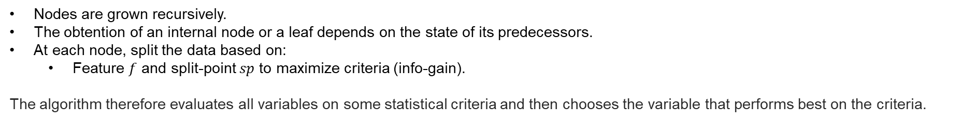
my humble ML course
Decision Tree construction/learning
Decision Tree construction/learning
Nodes are grown recursively.
The obtention of an internal node or a leaf depends on the state of its predecessors.
At each node, split the data based on:
Feature $f$ and split-point $sp$ to maximize criteria (info-gain).
The algorithm therefore evaluates all variables on some statistical criteria and then chooses the variable that performs best on the criteria.

Slide 8
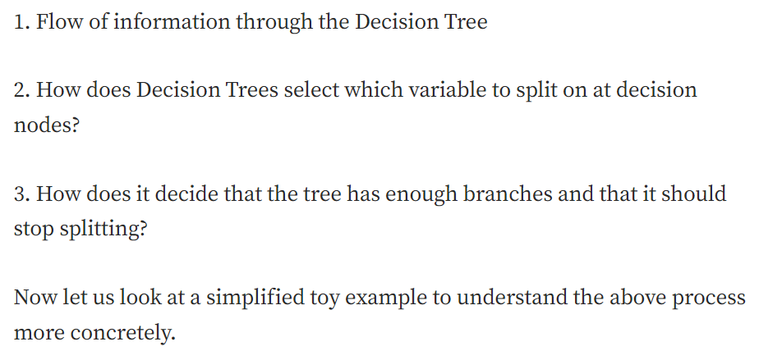
my humble ML course
Decision Tree data science perspective

Slide 9

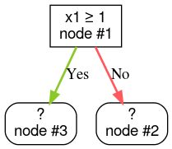
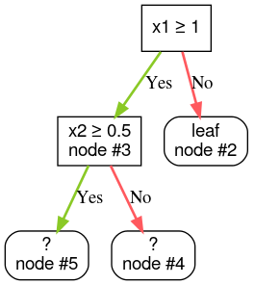
my humble ML course
DT growing algorithm
def train_decision_tree(training_examples): root = create_root() # Create a decision tree with a single empty root. grow_tree(root, training_examples) # Grow the root node. return root def grow_tree(node, examples): condition = find_best_condition(examples) # Find the best condition if condition is None: # No satisfying conditions were found, therefore the grow of the branch stops. set_leaf_prediction(node, examples) return # Create two childrens for the node. positive_child, negative_child = split_node(node, condition) # List the training examples used by each children. negative_examples = [example for example in examples if not condition(example)] positive_examples = [example for example in examples if condition(example)] # Continue the growth of the children. grow_tree(negative_child, negative_examples) grow_tree(positive_child, positive_examples)

Slide 10
my humble ML course
Information
Information theory is a subfield of mathematics concerned with transmitting data across a noisy channel.
Information theory is a field of study concerned with quantifying information for communication.
Measurements of information are widely used in artificial intelligence and machine learning, such as in the construction of decision trees and the optimization of classifier models.
The intuition behind quantifying information is the idea of measuring how much surprise there is in an event. Those events that are rare (low probability) are more surprising and therefore have more information than those events that are common (high probability).

Slide 11
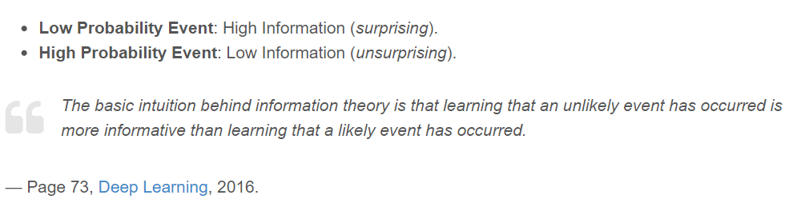
my humble ML course
Information
.

Slide 12
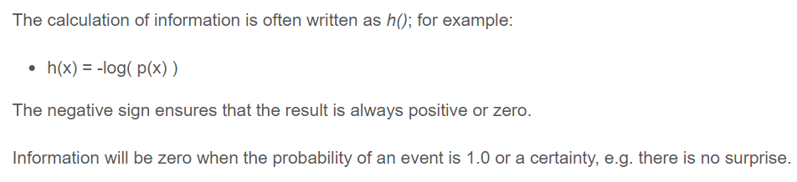
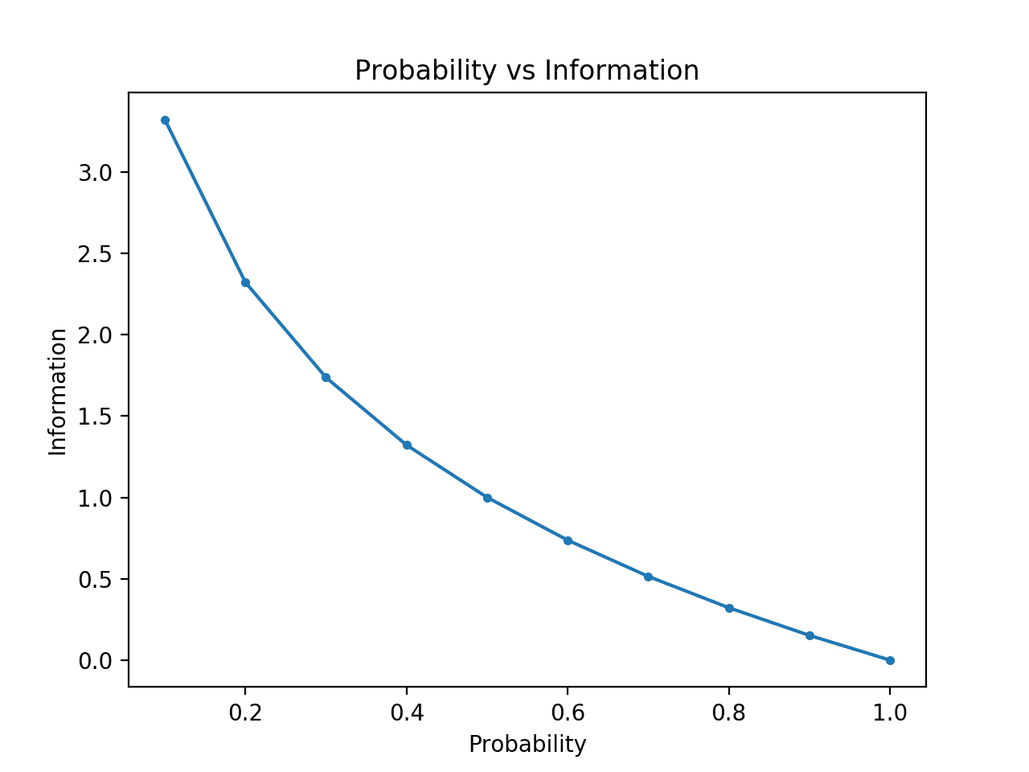
my humble ML course
Information
.

Slide 13
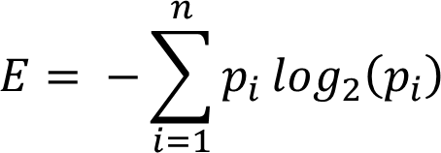
my humble ML course
Entropy and Information Gain
Entropy is a scientific concept as well as a measurable physical property that is most commonly associated with a state of disorder, randomness, or uncertainty.
In information theory, the entropy of a random variable is the average level of “information”, “surprise”, or “uncertainty” inherent to the variable’s possible outcomes.
In the context of Decision Trees, entropy is a measure of disorder or impurity in a node.
El nodo se divide donde se maximiza InfoGain
Notes:
probabilidad de pertenecer a la clase i
informacion de pertenecer a la clase I

Slide 14
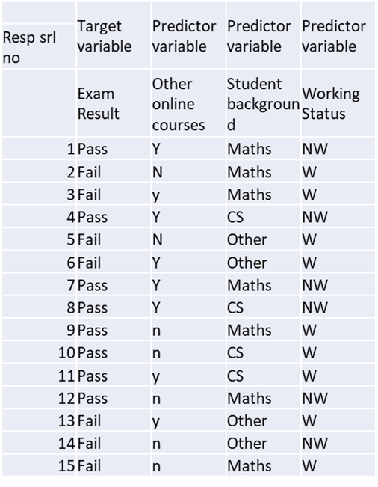
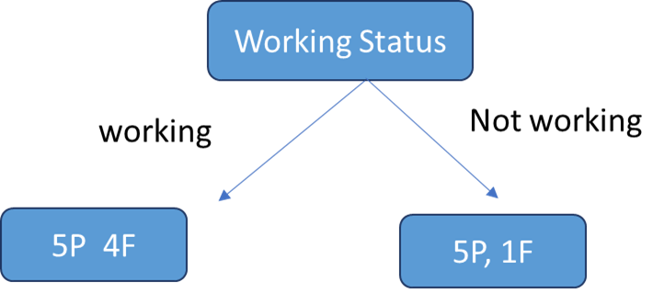
my humble ML course
Entropy and Information Gain
Notes:
probabilidad de pertenecer a la clase i
informacion de pertenecer a la clase I

Slide 15
my humble ML course
Entropy and Information Gain
Notes:
probabilidad de pertenecer a la clase i
informacion de pertenecer a la clase I

Slide 16
my humble ML course
Entropy and Information Gain
Notes:
probabilidad de pertenecer a la clase i
informacion de pertenecer a la clase I

Slide 17

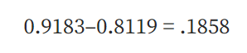
my humble ML course
Entropy and Information Gain
Notes:
probabilidad de pertenecer a la clase i
informacion de pertenecer a la clase I

Slide 18
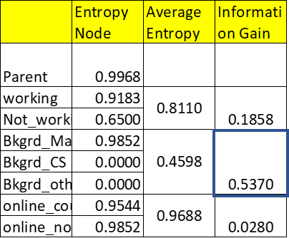
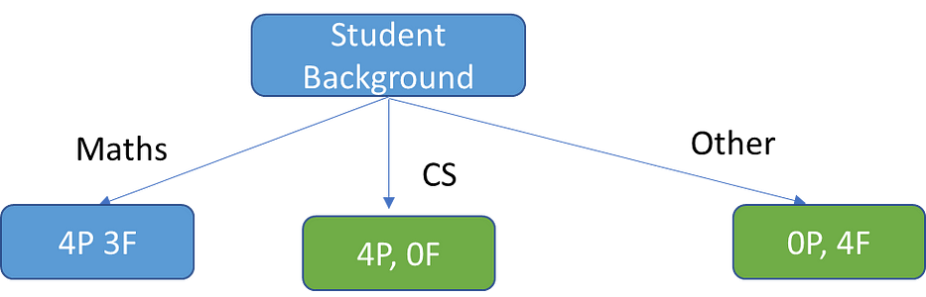
my humble ML course
Entropy and Information Gain
Notes:
probabilidad de pertenecer a la clase i
informacion de pertenecer a la clase I

Slide 19
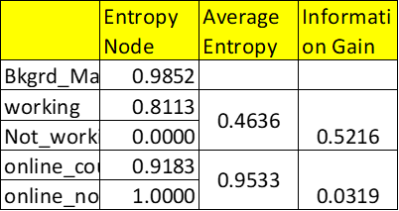
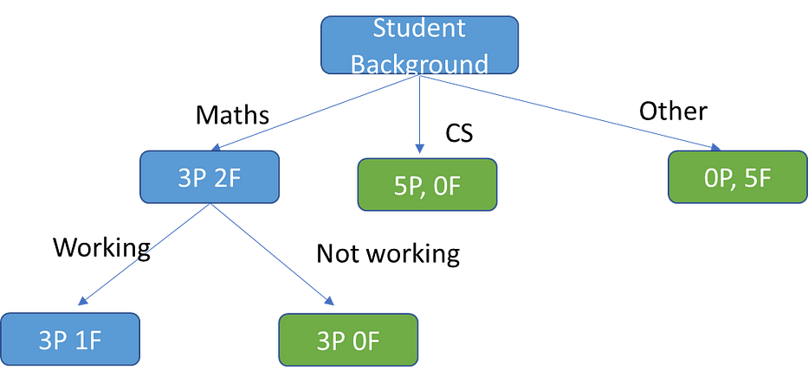
my humble ML course
Notes:
probabilidad de pertenecer a la clase i
informacion de pertenecer a la clase I

Slide 20

my humble ML course
Gini Index
The Gini Index or Impurity measures the probability for a random instance being misclassified when chosen randomly
Calculates the amount of probability of a specific feature that is classified incorrectly when selected randomly.
The Gini index has a maximum impurity is 0.5 and maximum purity is 0, whereas Entropy has a maximum impurity of 1 and maximum purity is 0.
Se divide el nodo de menor pureza

Slide 21



my humble ML course
Gini Index
4

Slide 22
my humble ML course
Bibliography
https://machinelearningmastery.com/what-is-information-entropy/
https://towardsdatascience.com/decision-trees-explained-entropy-information-gain-gini-index-ccp-pruning-4d78070db36c
https://medium.com/analytics-steps/understanding-the-gini-index-and-information-gain-in-decision-trees-ab4720518ba8
https://github.com/kamperh/data414
https://polakowo.io/datadocs/docs/machine-learning/tree-based-models
https://towardsdatascience.com/why-random-forests-outperform-decision-trees-1b0f175a0b5
https://www.statistics.cool/post/why-do-random-forests-work/
https://luisvalesilva.com/datasimple/random_forests.html
https://developers.google.com/machine-learning/decision-forests/growing?hl=es-419
Notes:
https://miro.com/app/board/uXjVMZythnw=/

Slide 23
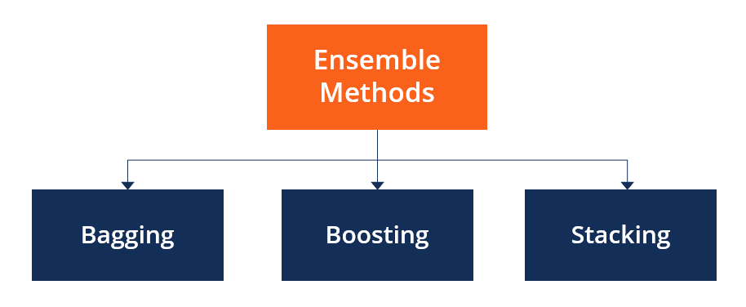
C4 – Ensemble learning
my humble ML course

Slide 24
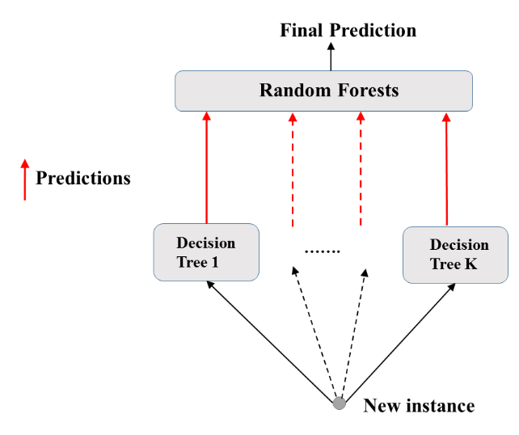
my humble ML course
Random Forests
TODO
Notes:
tree based models in Google

Slide 25
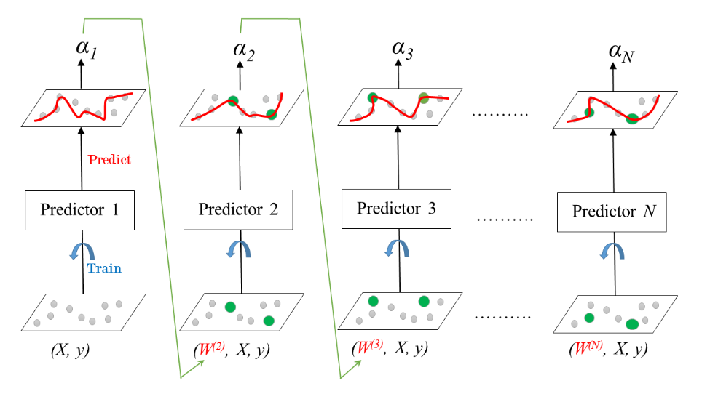
my humble ML course
AdaBoost
TODO
Notes:
tree based models in Google

Slide 26
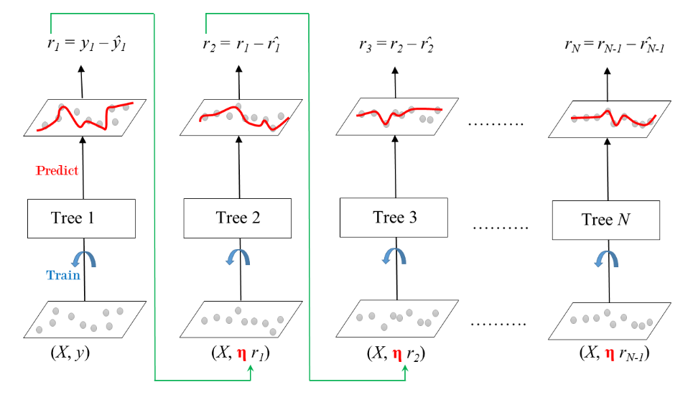
my humble ML course
GBM (Gradient Boosting Machine)
TODO
Notes:
tree based models in Google

Slide 27
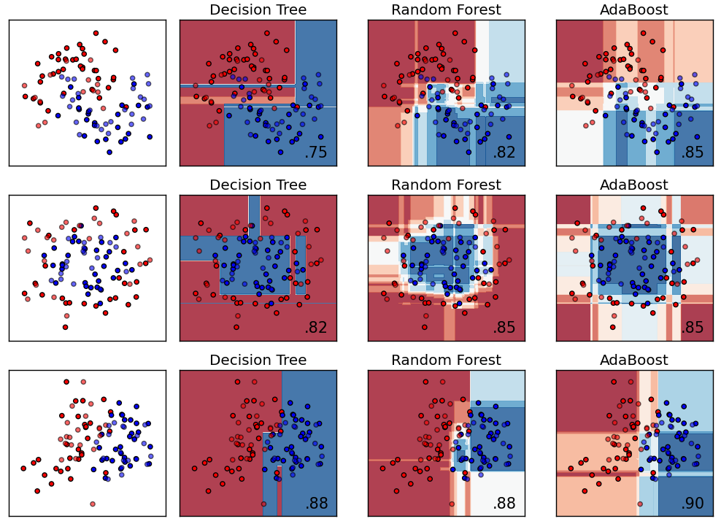
my humble ML course
more tree based models
TODO
Notes:
tree based models in Google

